Slide 1
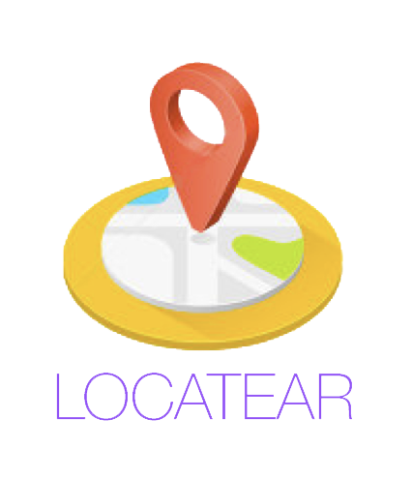
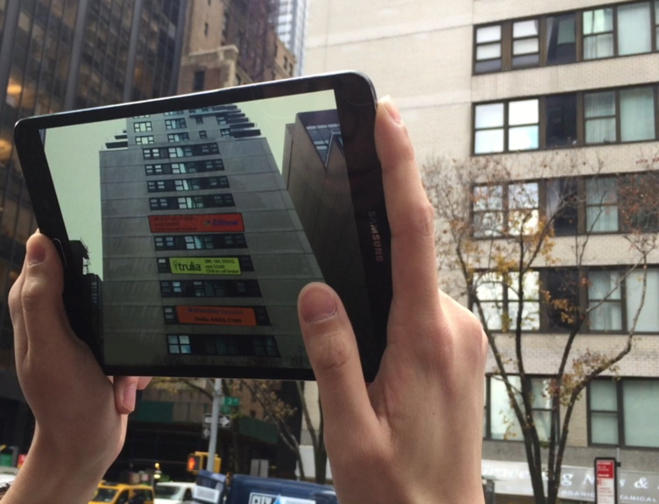
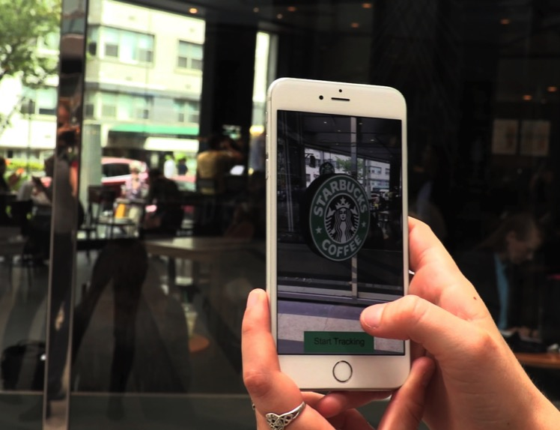
LOCATEAR A Glimpse Group Company
Augment Your World Location Based Augmented Reality Experiences

Slide 2
The ability to walk down a street and view projected information relating to restaurants, retailers, real estate or financial firms will vastly enhance the way people are able to interact and do business with the environment around them.
- Liron Lerman General Manager, LocateAR

Slide 3
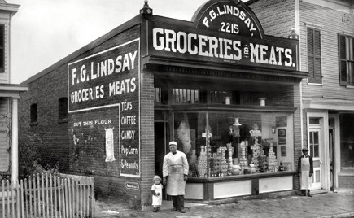
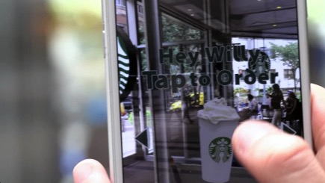
An Evolution In Storefront Promotions
Business owners have always been seeking revolutionary ways to attract costumers.
Storefronts have become a sophisticated tool to attract customers and increase engagement, yet remain limited in scope and complicated to change.
LocateAR allows customers to interact with promotions in Augmented Reality (AR) on their mobile devices, and businesses to employ multiple storefront campaigns that can be tailored to specific demographics and changed instantaneously.

Slide 4
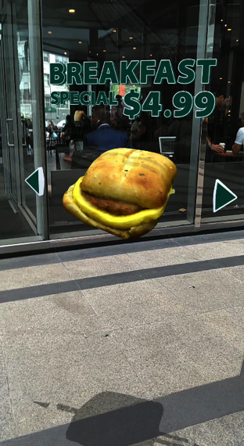
LocateAR
An Augmented Reality (AR) geolocation platform that enables businesses to rapidly develop and deploy targeted and specialized location‐based AR experiences for their customers.

Slide 5
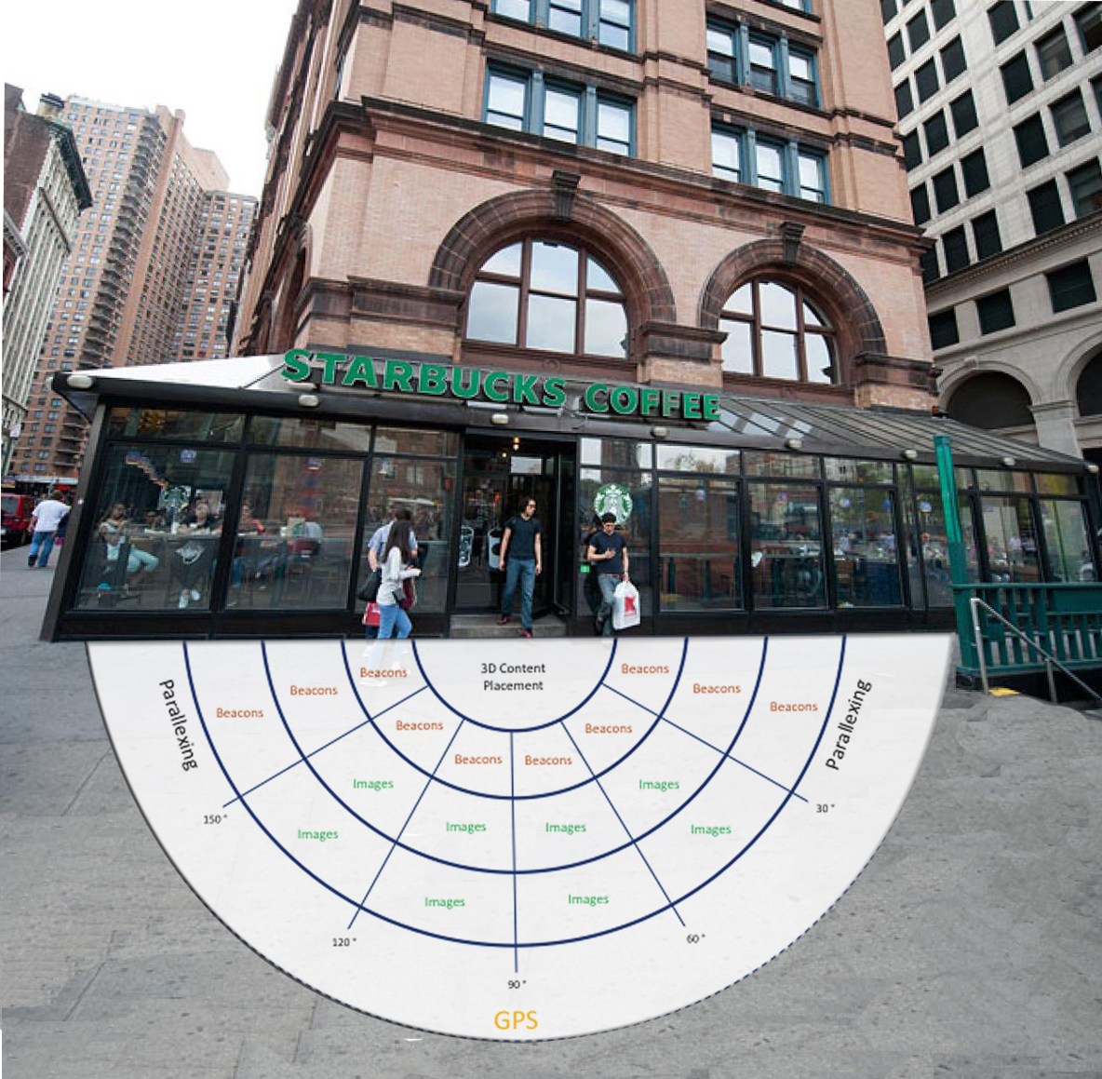
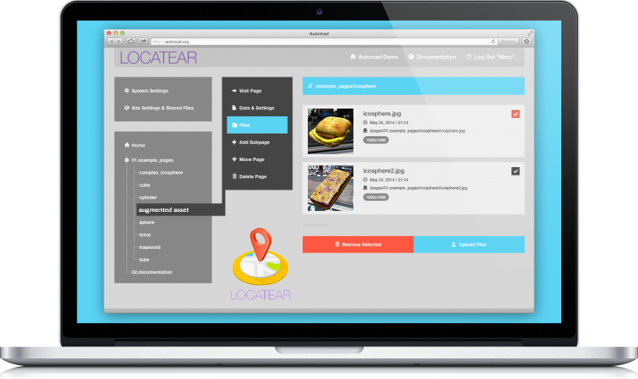
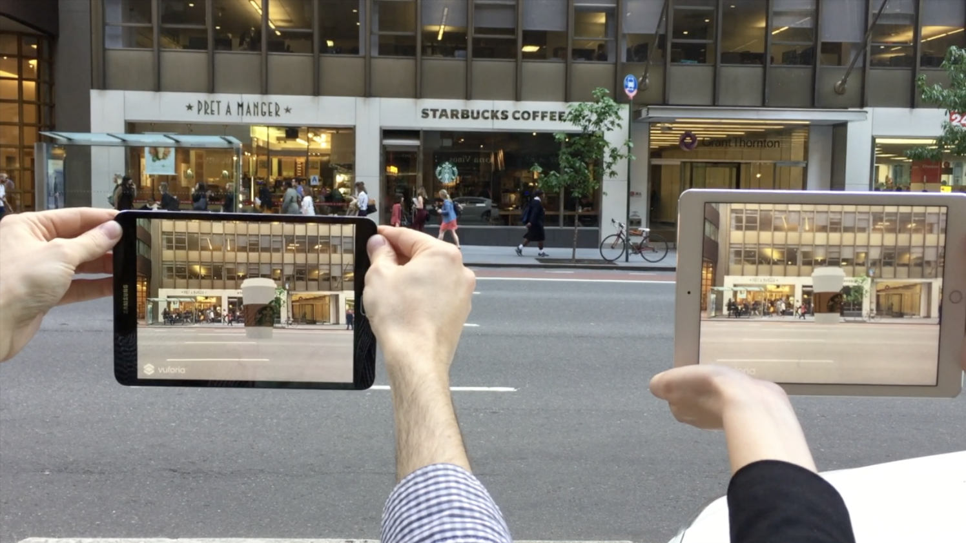
LocateAR Service Model Structure
Gathering App
Uses the business location photos, beacons, GPS and WiFi through cloud service
Web Service
Owners upload and select content to display to varying demographics
Display App and SDK
A native app to view AR content that companies can embed in their own apps

Slide 6
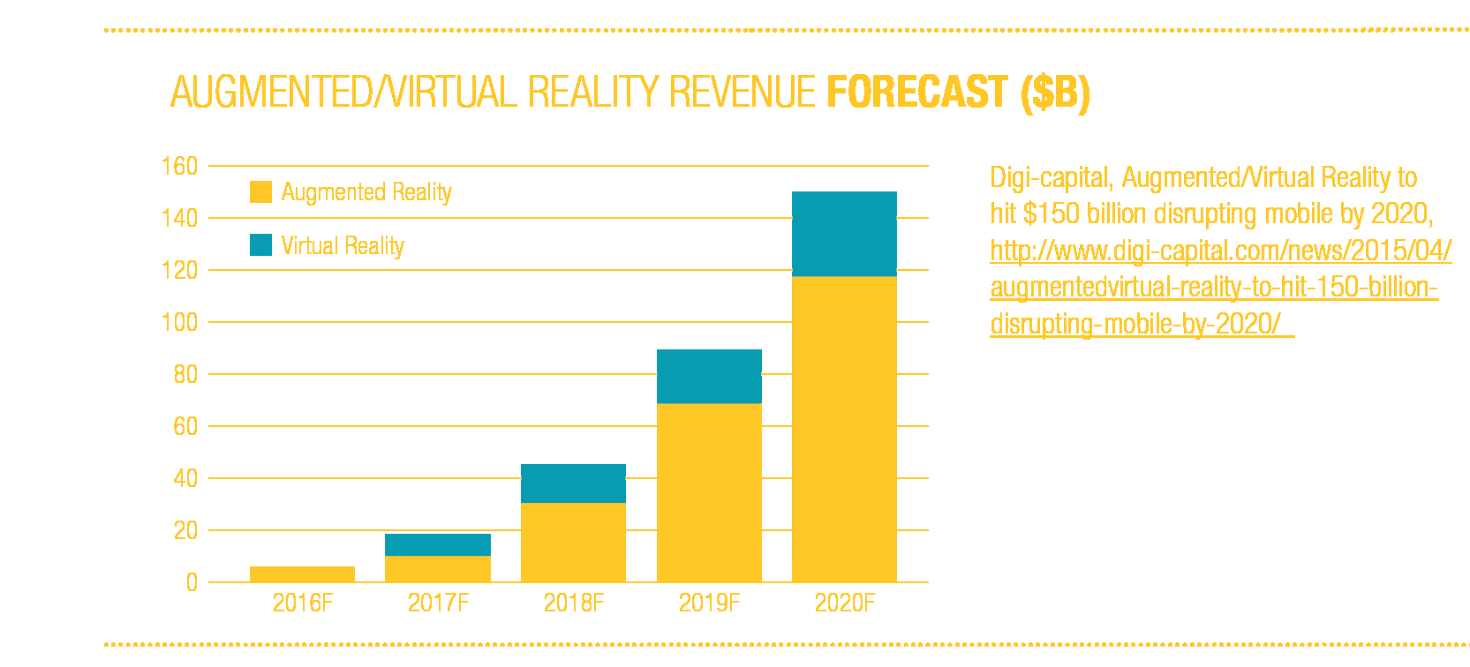
Immersive Market Capitalization
Revenue from Augmented Reality is projected to be four times as high as that of VR by 2020. AR/VR could hit $150bn in revenue by 2020, with AR taking around $120 billion and VR $30 billion, according to Digi-capital.

Slide 7
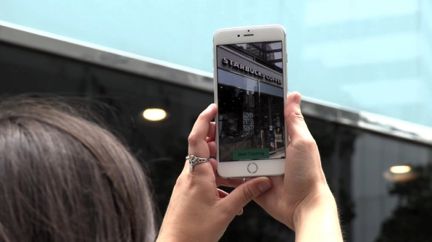
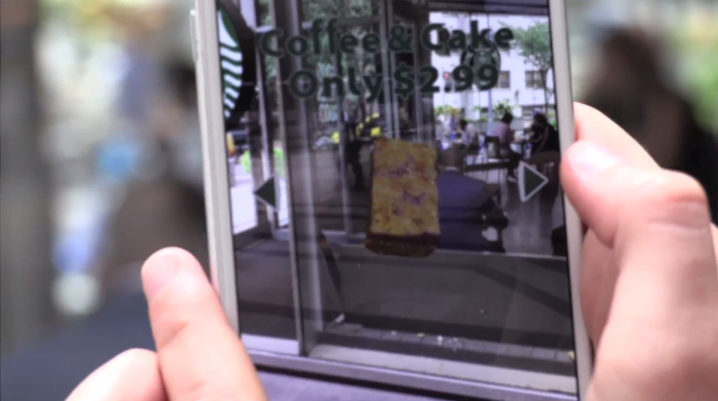
LocateAR Rewards Deal Seekers
Prompts Special Offers
for AR Customers
Scan
Storefronts
Enables in-the-know customers to scan storefronts for special deals and unlock secret offers unique to AR only users
Allows businesses to target select demographics using data analysis

Slide 8
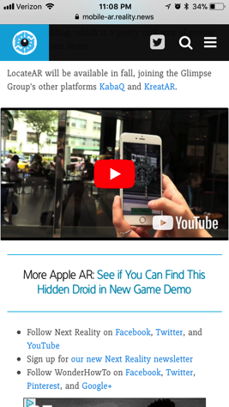
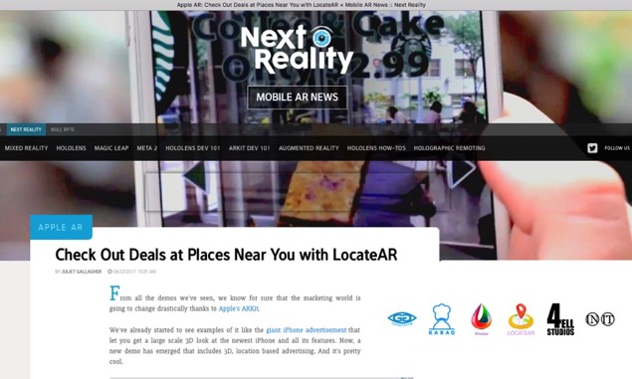
Featured Content (links)
Check out our tech feature:
‪buff.ly/2vlx5tW
Watch our YouTube video:
https://youtu.be/FrQ4Oqzdi0Y

Slide 9
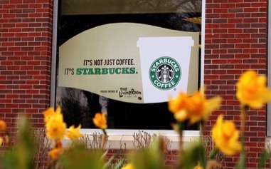
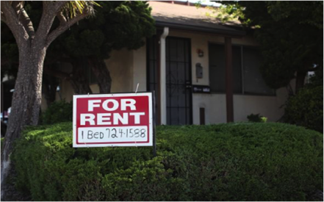
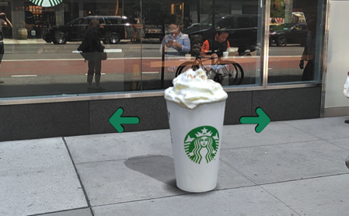
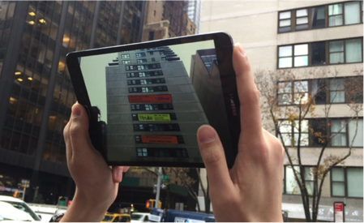
Enhancing Efficiency & Design Across Industries
Restaurants
Real Estate
Travel/Tourism
From...flat window promotions that block interior light and street views
From...static, generic, reused signage
From...reading tourist guidelines at a landmark destination
To...virtual interactive content that can be used for in-store transactions
To...an interactive exploration of listings and connection with brokers
To...a virtual tour guide sharing historic info w/ visual enhancements
9

Slide 10
Data Analytics Implementation for AR
Clothing Store | If cold | If female | Scarf
 |  | If male | Gloves
 | If sunny | If female | Sun hat
 |  | If male | Baseball cap
Café | Item 1 | If morning | Non-Vegan | Ham & Egg Brioche | Vegan | Oatmeal
 |  | If evening |  | Turkey Pesto Sandwich |  | Salad
 | Item 2 | If warm | Coffee | Cold Brew | Tea | Iced Tea
 |  | If cold |  | Pumpkin Latte |  | Chai Latte
10

Slide 11
LocateAR SDK & API
Kreatar Presentation App
The platform has both a Software Development Kit (SDK) and Application Program Interface (API) that can integrate into new or existing apps to enable additional functionality.
Tourism App
KabaQ
AR Food App
LocateAR
Real Estate Apps
Games
Wikipedia

Slide 12
Summary
Revolutionize location based business
Utilize consumer data analysis
Target specific consumer demographics
Incorporate AR GPS placement accuracy
Offer location based AR incentives
Empower business owner participation

